Slide 1


Session 2
Storytelling &
Writing Masterclass
Building Your Breakthrough Voice
Ananya Narang | Founder, Entourage
Notes:
1

Slide 2
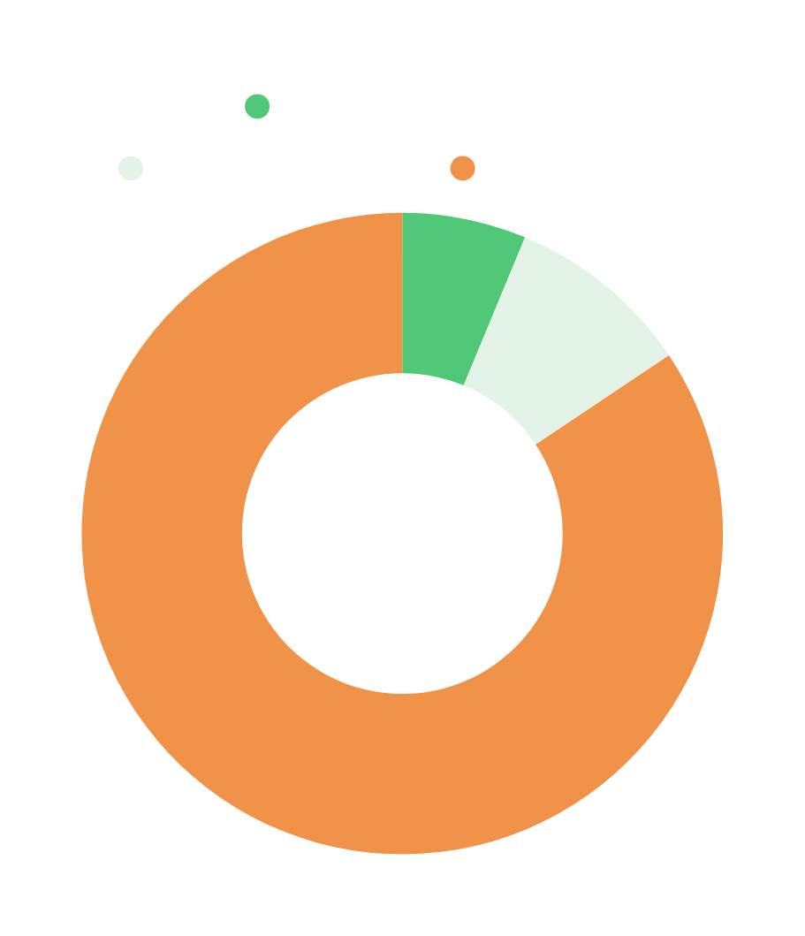
Posting Status
160
Total Students
15
Posted After Session 1
10
Got 50+ Likes
Notes:
2

Slide 3
What This Session Covers
The Writing
Playbook
The Reach-Out
Primer
Hooks that earn clicks
Post structure and emotion
Readability and mobile-first rules
The three formats
The commentable ending
Warm beats cold, every time
Message structure that earns replies
The builder's edge: lead with value
Draft one real message together
Notes:
3

Slide 4

Today's Agenda
01
Premise: Making a Stranger Stop
5 min
02
The Hook: Earning the First Click
20 min
03
Game: Hook Wars & Comparison
15 min
04
The Post: Structure and Emotion
10 min
05
Readability + The Wind-Up
15 min
06
The Three Formats + Live Examples
10 min
07
Reaching Out: The Warm Outreach Primer
15 min
08
Close + Assignment Brief
5 min
Notes:
4

Slide 5
Objective of the Day
Success of this class is measured when students will be able to:
1
Write a structured post with a click-earning hook and a comment-earning close
2
Understand the three content formats (personal story, case study, topical) and when to deploy each
3
Apply the full writing craft: anecdotal hooks, ABCD progression, mobile-first readability, 80/20 commentable ending
4
Draft a warm outreach message using the structure taught in Session 1's primer
Notes:
5

Slide 6
Opening: The Premise
Anyone can post.
Very few can make a stranger stop.
That skill is learnable. And it has rules.
Today's objective: give the reader a dopamine hit in every sentence of every post.
Notes:
6

Slide 7
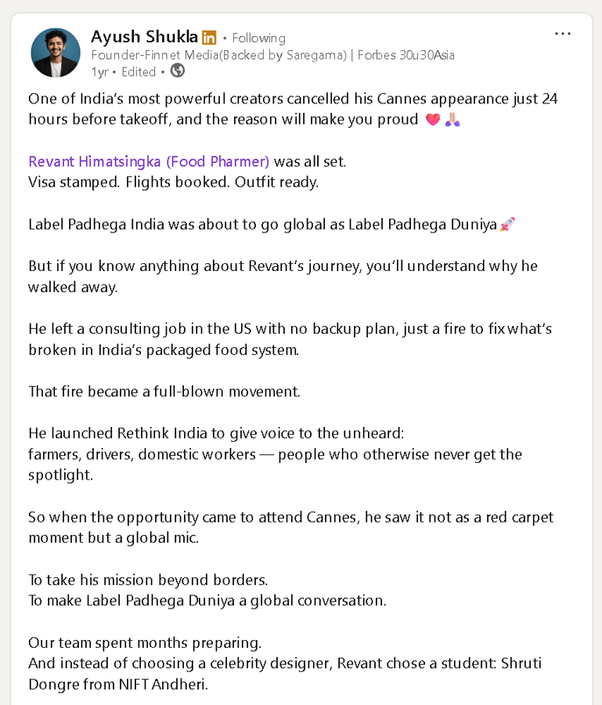
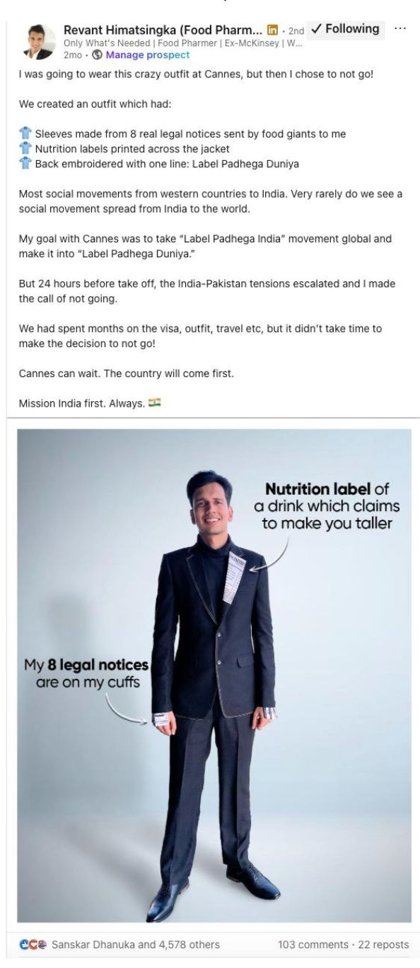
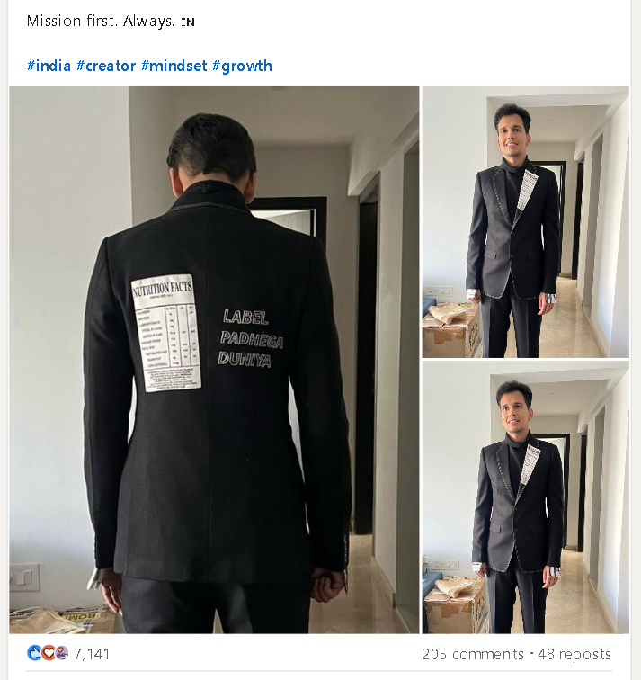
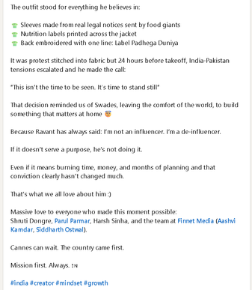
Guess: Which Post Performed Better?
VS
Ayush Shukla’s Post
Revant’s Post
Notes:
7

Slide 8
The Answer: Content Quality Wins
WINNER
VS
Notes:
7

Slide 9
But Why?
1
Narrative Arc
Ayush builds a complete story; Revant captures only the moment.
2
Reader-Centric Framing
Ayush creates emotion; Revant focuses on information.
3
Zoomed-Out Takeaway
Ayush ends with a larger belief; Revant ends with the decision.
4
Richer Storytelling
Ayush adds characters and context; Revant keeps the story one-dimensional.
5
Cultural Resonance
Ayush connects the story to Swades; Revant misses a larger emotional anchor.
Notes:
7

Slide 10
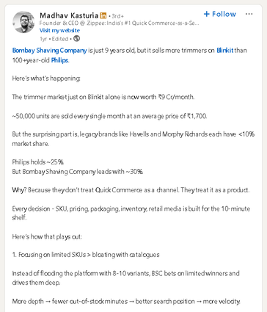
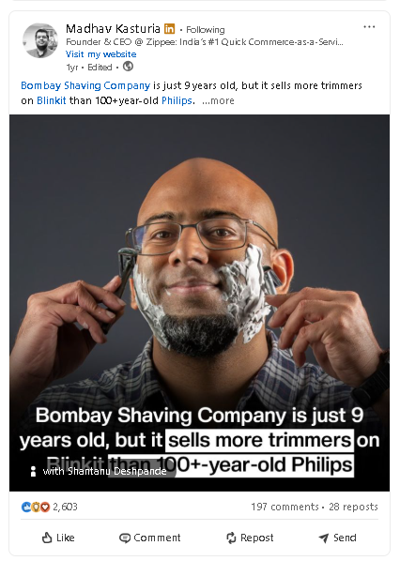
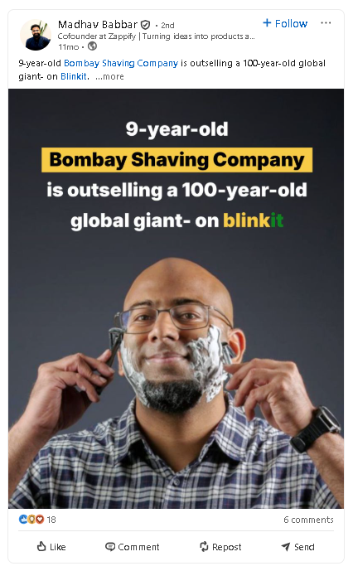
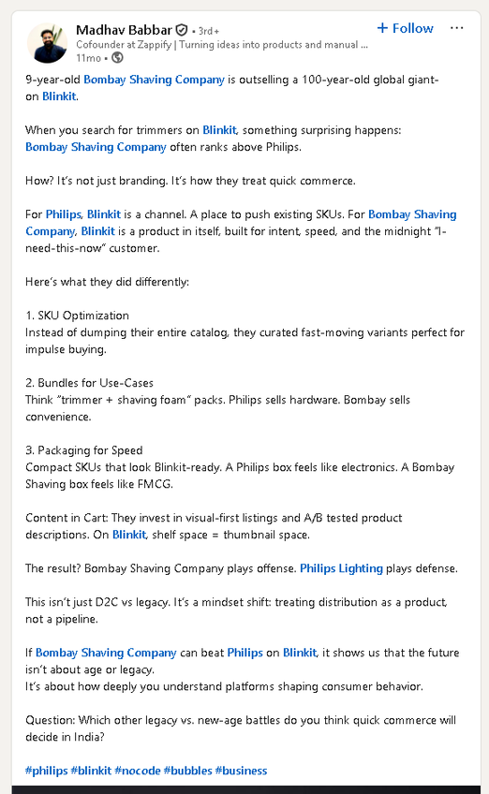
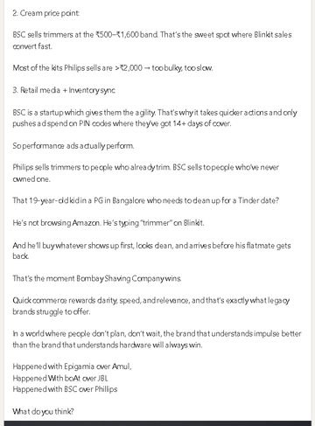
Guess: Which Post Performed Better?
VS
Madhav Kasturia’s Post
Madhav Babbar’s Post
Notes:
7

Slide 11
The Answer: Content Quality Wins
WINNER
VS
Notes:
8

Slide 12
But Why?
1
Curiosity Before Explanation
Kasturia first shows the surprising part then explains why; Babbar reveals the thesis almost immediately.
2
Numbers Build Credibility
Kasturia uses market size, units sold, price points and market share; Babbar makes largely qualitative claims.
3
More Tactical Detail
Kasturia explains SKU depth, pricing and inventory with specifics; Babbar keeps the same ideas broader.
4
Clearer Cause → Effect
Kasturia connects each action to outcomes; Babbar mostly states what BSC does differently.
5
Insight Feels Discovered
Kasturia makes the reader arrive at qcom lesson through evidence; Babbar packages it as a framework.
Notes:
7

Slide 13
The Hook: Earning the First Click
The hook is the only thing visible before 'see more.' Get it wrong and nothing else matters.
Anecdotal, never philosophical
1
Open with something that happened, a real event or moment, never a grand abstract thought.
Never kill the suspense
2
'I lost everything' works because it does not yet say how. Tease the tension, withhold the resolution.
Add contrast
3
Anything extreme or counterintuitive. The mind wakes up at a contradiction.
Notes:
9

Slide 14
Hook Aura: Leveling Up
ADVANCED HOOK TECHNIQUES
1
Mind-blowing fact
Lead with a stat or reality that makes the reader's jaw drop.
2
Capitalize 1-2 words for impact
Strategic capitalization on the single most powerful word creates visual weight.
3
Numbers over words
12 beats 'a dozen.' 24 hours beats 'one day.' Numbers signal that you actually measured.
4
Add a topical hook
If your audience is already thinking about something, weave it into your opening.
Notes:
11

Slide 15
The Post: Structure and Emotion
Find the core before you write a single word.
Max two core elements, never five. Five threads means the reader holds none.
Pick ONE core emotion.
Do not explain both sides. Grey is forgettable. A strong, clear opinion earns the reaction.
ABCD progression: each line advances the reader, never restates. Avoid repetition religiously.
One thought per sentence. Subject before action: 'The boy hit the ball,' never 'The ball was hit by the boy.'
Use punchy phrases over full sentences when it lands harder, even if grammar breaks.
Notes:
12

Slide 16
Pick ONE Core Emotion
1
Controversial / Counterintuitive
Strongest engagement driver. A take nobody expects.
2
Humor
Disarms the reader. Hard to do well, devastating when it lands.
3
Mystery / Curiosity
The reader has to know what happens next. Suspense pulls them forward.
4
Inspiration / Motivation
Only works when backed by real credibility and proof.
5
Sarcasm
Sharp, knowing, and niche. Builds a cult following when consistent.
6
Nostalgia
Universally relatable. Works best with extreme specificity.
Notes:
13

Slide 17
Readability: Mobile-First Rules
NON-NEGOTIABLE
10
3
0
No sentence
over ~10 words
No paragraph
over 3 rows
No fancy
vocabulary
White space is your friend. Let every sentence breathe.
Keep it short: half a page to one page. Shorter-and-finished beats longer-and-abandoned.
Build in relatability: something the reader sees or feels day-to-day, or a topical hook they are already thinking about.
Notes:
14

Slide 18
The Commentable Ending
80%
20%
SPECIFIC STORY
GENERAL THOUGHT
Your real experience, your specific details, your concrete examples.
Opens into something universal people can comment on.
NEVER a limp 'What do you think?'
NEVER a commercial pitch.
The ending should be a thought turned
into thought leadership, a real point of
view, never generic philosophy.
Notes:
15

Slide 19
Writing Aura: Advanced Craft
Have something relatable in every post. Relatability means anything the reader can see, observe, or feel in their day-to-day life.
Have a mind-blowing fact. The more unexpected, the more people stop scrolling.
Have a bold interesting thought which is easy to understand. Complexity kills engagement.
Have humorous punches. Wit breaks tension and earns saves.
Connect dots between two unrelated things. The unexpected connection is the insight nobody else sees.
Structure can be a game changer. The same thought presented differently can 10x your reach.
Dopamine hit in every line. That is the standard.
Notes:
16

Slide 20
Post Hygiene Checklist
✓
Pointers should be symmetric and visually clean
✓
Use phrases instead of complete sentences when it creates more impact
✓
Subject before action: 'The boy hit the ball' reads better than 'The ball was hit by the boy'
✓
Use emojis but do not overload (2 to 5 max)
✓
Check for grammatical and spelling errors before publishing
✓
Post length: half a page to one page. Max 1.5 pages.
Notes:
17

Slide 21
Format 1: Personal Story
Clear start, middle, and end. Be clear with the point you are making, especially the ending.
Load all parts of the story. Each section needs weight and substance.
ABCD framework for progression. Every line moves the reader forward, never circles back.
80% story, final 20% is a general thought to increase commentability.
Specificity creates realistic imagination. Details of time, place, and feeling make the reader see it.
Flowery language does not mean more impact. Flowery = toxic positivity. Cut it every time.
Notes:
18

Slide 22
Format 2: Case Study
YOUR UNFAIR ADVANTAGE
1
Lead with the surprising result
Open with the outcome that makes people curious about the thinking behind it.
2
Walk the thinking
Show the process, the decisions, the tradeoffs.
3
Extract the transferable lesson
What can the reader apply to their own work? This is what makes it saveable.
Take a real Mesa project. You already have the raw material.
Notes:
19

Slide 23
Format 3: Topical
TIMING IS EVERYTHING
USP: Speed
USP: Thought
Post within minutes of a development breaking. Be the first voice in your audience's feed.
If you are late, bring a genuinely strong angle the fast movers missed. The second-order insight, the contrarian read.
A topical post with no speed and no unique thought is noise.
Notes:
20

Slide 24
Your AI Writing System
PROMPT 1
The Setup (use this first, every time)
You are a LinkedIn ghostwriter. Your job is to write posts that give the reader a dopamine hit in every single sentence.
Before writing anything, ask yourself: What's the one wow-factor? (A killer story, strong data, or a counterintuitive insight. If none exists, the post has no reason to exist.) What's the core emotion? Pick one: Controversial, Humor, Mystery, Inspiration, or Sarcasm.
Rules that cannot be broken:
Hook must be anecdotal or data-led. No philosophy. No questions. Don't reveal the ending.
No sentence longer than 10 words. No paragraph longer than 3 lines.
Strong opinion only. Pick a side. Don't explain both sides.
Say the thing once. Move on. Never repeat a thought.
No adverbs. No flowery language. No "excited to share" or "humbled."
End with something the reader can comment on: a specific thought turned into a broader human truth.
PROMPT 2
Writing the Post
Write a LinkedIn post on this idea: [YOUR IDEA]
My audience is: [founders / marketers / students / etc.]
My tone is: [casual and sharp / warm but direct / dry humor / etc.]
The wow-factor in this story is: [the data point / the twist / the moment]
Write 3 different versions, each with a different hook. Then give me the version you think is strongest and why.

Slide 25
Your AI Writing System
PROMPT 3
For Research-Backed Posts
I want to write a data-driven LinkedIn post on: [YOUR TOPIC]
First, research this topic and find:
3-5 data points that are surprising or counterintuitive (not well-known facts)
1 expert quote or industry insight
1 brand or company example that proves the point
Then write the post. Lead with the most surprising data point as the hook. Give me a strong opinionated ending:
not a balanced take, a clear prediction or stance.
PROMPT 4
When the Draft Isn't Landing
This draft isn't working. Here's what feels wrong: [describe the problem: too generic / too long / hook is weak / ending is flat]
Don't rewrite the whole thing. Just fix the specific problem. Give me 5 options for [the hook / the ending / this one section],
each structurally different from the others.

Slide 26

Time to do some real work!

Slide 27
Reaching Out: The Warm Outreach Primer
The writing rules you just learned apply directly to a great outreach message.
Warm beats cold, every time. For 2 to 3 weeks before you message someone, show up in their world: substantive comments, share their work with your take.
30 seconds to read. One line to answer. That is the bar your outreach message has to clear.
The builder's edge: lead with something to give. A teardown or a real insight flips you from student-asking-a-favor to operator-sharing-value.
Session 4 goes deeper on outreach and leverage. Today, you draft one real message together to close.
Notes:
22

Slide 28
The Outreach Message Structure
1
Specific genuine reason
Reference something they actually did. 'I saw your post on [X] and your take on [Y] stuck with me because [Z].'
2
Brief who-you-are
One line. Your positioning. 'I'm a Mesa student building [domain], working on [project].'
3
ONE low-friction ask
Effortless to say yes. A 15-minute chat, a single question, a quick reaction.
4
Lead with something to give
A teardown, a real insight, a useful observation. This flips the dynamic from asking to offering.
Notes:
23

Slide 29
Friday Post
OPTION A
OPTION B
The Personal Story Post
The Case Study Post
One true story from your journey using the full craft: anecdotal hook, ABCD build, commentable 80/20 ending.
This doubles as your first Featured-section asset.
A real Mesa project as proof of how you think. Lead with the surprising result, then the thinking, then the lesson.
Pick one. Ship it this Friday using the full writing craft.
Notes:
26

Slide 30
Before Next Class
1
Ship ONE Friday post (Option A or B)
Use the full writing craft: anecdotal hook, ABCD build, 80/20 commentable ending.
2
Write a second post in the other format
For practice. Ship it if it is ready.
3
Draft one warm outreach message
Using the four-part structure. If you have already engaged them, send it and log the reply.
4
Continue the daily habit
5 substantive comments a day in your topic cluster.
Notes:
27

Slide 31
One thing to remember:
The rules are learnable.
The craft is practicable.
The only variable is
whether you ship.
Write it. Publish it. Run the protocol. Repeat.
Notes:
28

